Slide 1
D R A F T
Notes:
Thank you for the opportunity to talk with you about Bold Moves.
To begin… what is it and why are we doing it?

Slide 2
D R A F T
Notes:
As we envision it, this is a new campus-wide initiative to identify large-scale transformational ideas at the university that build on the strengths of Wayne State, while helping to uncover significant fundraising opportunities.
We’re currently calling it Bold Moves, because we’re hoping to inspire bold ideas that offer a vision of the future.
This effort is being led by the Provost and Susan.
And it is an initiative we’re pursuing now for several reasons.

Slide 3
D R A F T
Notes:
Pivotal Moments successfully completed
Near completion of Distinctly Wayne State,
we have shown we can set goals and reach them.
Now it’s time to develop new priorities, that could attract significant support from donor investors… those big, multi-million dollar donors who want to make a significant impact with their philanthropy.
That is one reason why we are launching this university-wide initiative to inspire faculty and others to think big and imagine transformational ideas.

Slide 4
D R A F T
Notes:
The EAB Advancement Forum has done some research and analysis about donor investors and campaign fundraising, and they have discovered some challenges.

Slide 5
D R A F T
Notes:
EAB found that donor investors view their philanthropy as an investment in the institution and they seek:
- Transformative impact
- Compelling ideas, and
- Connections with people doing the work

Slide 6
D R A F T
Notes:
EAB took four institutions in creating this process:
the University of Oregon,
the College of Charleston,
Valpraiso University and
University of California, Davis
These universities were seeking to identify and capture large-scale ideas that
are meaningful to the institution,
have the potential to be transformative,
and that could be of interest to those funders capable of making a significant investment and who want to make a deep impact.

Slide 7
D R A F T
Notes:
This is what happened at two of those universities in recent years.
[[Go through numbers]]

Slide 8
D R A F T
Notes:
Here is a subset of examples from the UC-Davis process
I should point out that searching for transformational ideas, there will be many suggestions that are not selected as campaign priorities, but could become unit priorities and potentially match with a donor interested in that area.
So, how do we get from here to large-scale, high impact projects at Wayne State. There’s a process.

Slide 9
D R A F T
Notes:
And to be successful, the process must be:
transparent
highly-communicated and
easy to understand.

Slide 10
D R A F T
Notes:
To make decisions and move the initiative forward, a steering committee was developed, similar to those that have been created at other universities.
It has these people (name them). We have had three meetings so far, with one more scheduled, and probably one or two more beyond that.

Slide 11
D R A F T
Notes:
And here is where we’re at with our criteria.

Slide 12
D R A F T
Notes:
The steering committee is also deciding on scoring, timeline and process.
There is a two step process, but review and activity occur between the two steps.

Slide 13
D R A F T
Notes:
This is our proposed initial submission form.
Details for the full proposal have yet to be determined.

Slide 14
D R A F T

Slide 15
D R A F T
Notes:
Our draft timeline is as follows:

Slide 16
D R A F T

Slide 17
D R A F T

Slide 18
D R A F T

Slide 19
D R A F T

Slide 20
D R A F T

Slide 21
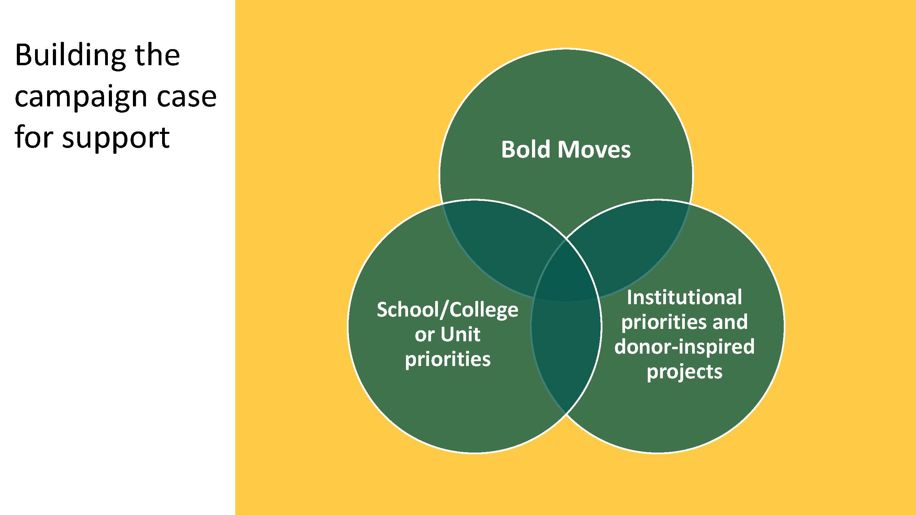
D R A F T

Slide 22
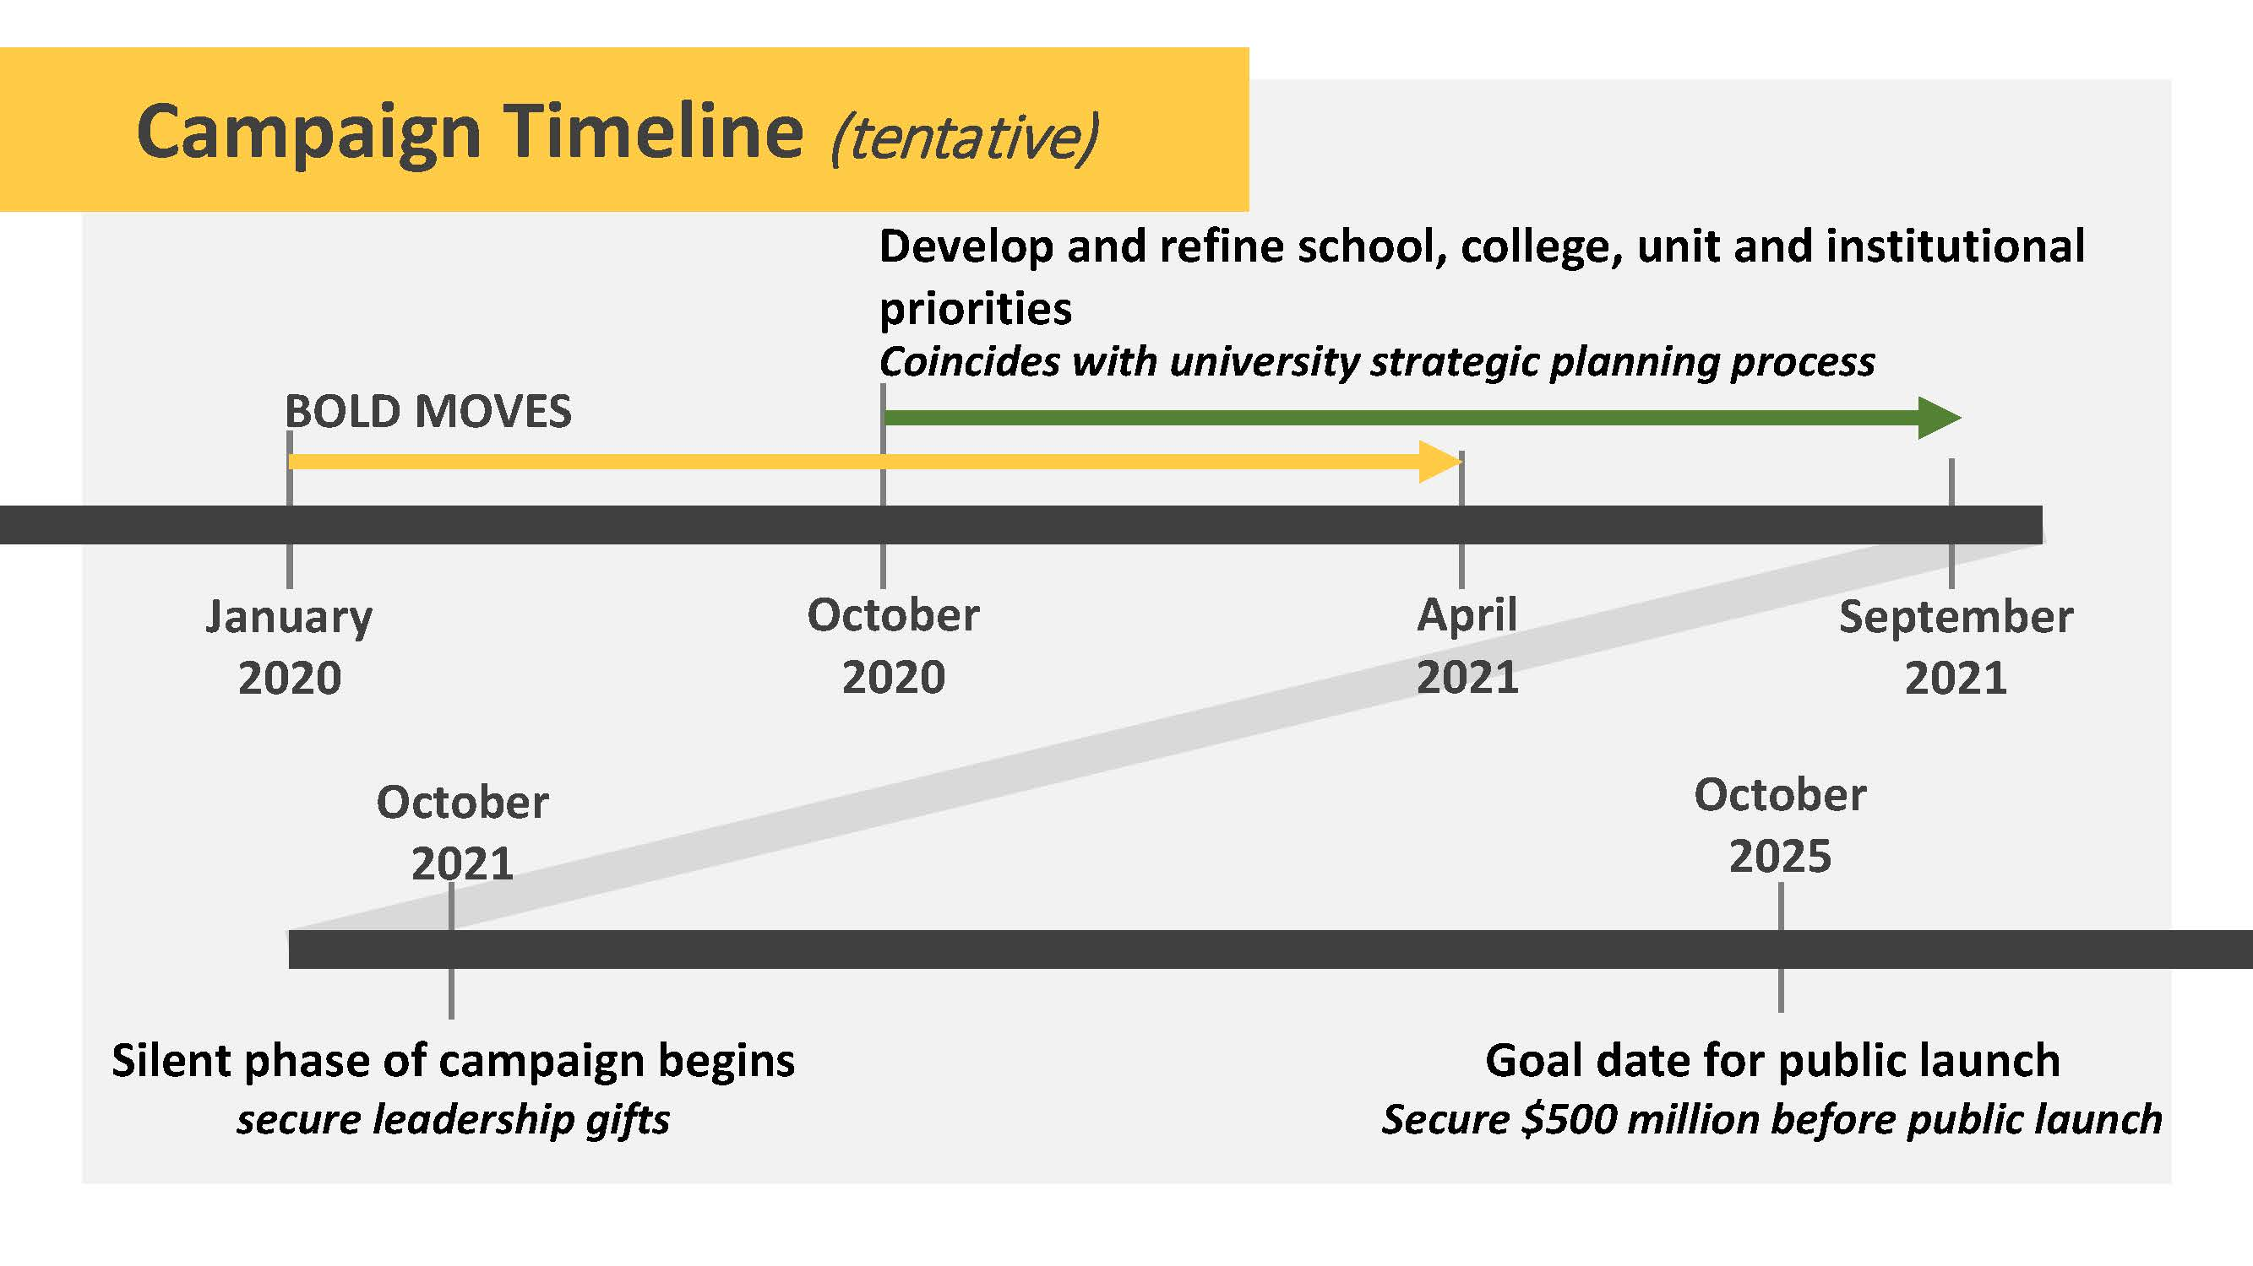
D R A F T

Slide 23
D R A F T

